Slide 1

Data Aggregation and Analysis Challenges for Intelligent Manufacturing
Wolfram Data Summit
September 4, 2014
Robert Graybill
President & CEO
Robert.graybill@nimbisservices.com
www.nimbisservices.com
https://smartmanufacturingcoalition.org
Notes:
As you heard in the introduction and the industry panel, the SMLC has looked across industries and problems to tackle areas that no one company can address alone. The overarching conclusion has been on industry-wide infrastructure called the SM Platform that can:
Support pervasive orchestration and application of enterprise manufacturing intelligence (actionable data, analytics and models) ‘horizontally’ bridging 40 years of optimized compartmentalization in operations, departments, vendors, time scales and companies.
Support global and integrated metrics for dynamic management and driving next generation manufacturing that can no longer operate under the assumption that optimized departments lead to optimized and resilient enterprises.
Addresses time and cyber physical synchronization for actionable orchestration of data and information and dynamic management
Addresses design and manufacturing data, analytics and models as integrated life cycle to support new technology infusion, ICME, source material and product validation
Offers access and lowers the cost and risk barriers to networked information, data and modeling technologies at the level of sophistication and need for small, medium and large companies
Facilitates a broad, market driven base of innovation in manufacturing intelligence applications
Address new business models

Slide 2

An Industry-Driven Open Architecture Shared Infrastructure
Smart Manufacturing
SMLC Partnerships
“Information that drives the next century’s structural shift in manufacturing.”
Test Beds - General Dynamics, General Electric, General Mills, General Motors, Praxair, Corning, Pfizer, NETL, Alcoa, Owens Corning, Advanced Manufacturing Partnership SoCal, Southwest Research Institute Design/Manufacturing Platform Providers – JPL/NASA, UCLA, Rockwell, Honeywell, Emerson, Schneider Electric, Nimbis, OSISoft, Savigent Modeling & Simulation Materials, Design, Manufacturing – Caltech/JPL, UCLA, UT Austin, Tulane, NCSU, CMU, Purdue Smart Manufacturing/Smart Grid – EPRI Global Metrics/Outreach – AIChE, ASQ, AMT, ACEEE, NCMS, MESA, MT Connect, Society of Manufacturing Engineers (SME), Sustainable Solutions, Spitzer & Boyes Agency partners – DOE, NIST, NSF Regional Partners –Center for Advanced Technology Systems/RPI, Wisconsin Manufacturing Institute, AMP SoCal, Association of State Energy Research & Technology Transfer Institutions (ASERTTI), National Association of State Energy Officials (NASEO)
Smart Manufacturing Leadership Coalition (SMLC) – 501c (6)
Making real-time info available:
when it is needed,
where it is needed
and in the form it is needed throughout the Manufacturing ecosystem

Slide 3
The challenge for 21st Century Smart Manufacturing (SM) is manufacturing in which all information is available when it is needed, where it is needed, and in the form it is most useful to drive optimal actions and responses. SM also encompasses the sophisticated practice of generating and applying data-driven Manufacturing Intelligence throughout the lifecycle of design, engineering, planning and production. Manufacturing intelligence is a deep, comprehensive behavioral understanding of the manufacturing process through data and modeling, which can create a new capacity to observe and take action on integrated patterns of operation through networked data, information, analytics, and metrics. Smart Manufacturing Leadership Coalition (SMLC), identified that by lowering the implementation barriers around cost, complexity, ease-of-use, and measurement availability through the use of an open cloud SM platform, the U.S. manufacturing industry could deploy foundational infrastructure for vertically and horizontally oriented manufacturing intelligence to collectively strengthen capability.
Intelligent Manufacturing Challenge
Notes:
As you heard in the introduction and the industry panel, the SMLC has looked across industries and problems to tackle areas that no one company can address alone. The overarching conclusion has been on industry-wide infrastructure called the SM Platform that can:
Support pervasive orchestration and application of enterprise manufacturing intelligence (actionable data, analytics and models) ‘horizontally’ bridging 40 years of optimized compartmentalization in operations, departments, vendors, time scales and companies.
Support global and integrated metrics for dynamic management and driving next generation manufacturing that can no longer operate under the assumption that optimized departments lead to optimized and resilient enterprises.
Addresses time and cyber physical synchronization for actionable orchestration of data and information and dynamic management
Addresses design and manufacturing data, analytics and models as integrated life cycle to support new technology infusion, ICME, source material and product validation
Offers access and lowers the cost and risk barriers to networked information, data and modeling technologies at the level of sophistication and need for small, medium and large companies
Facilitates a broad, market driven base of innovation in manufacturing intelligence applications
Address new business models

Slide 4
Manufacturing
Health & Sustainability Challenge
The Business of
Open Architecture Market, Valuation
of Data & Innovation
The Business Model
of Data
Collective Wisdom
Big Data
Collective
Innovation &
Practice
Practice Valuation
Collective vs. Proprietary
Converting Knowledge to
Wisdom
Smart Enterprise
Manufacturing
Smart
Open Architecture
Converting Information
to Knowledge
Smart Factory Manufacturing
Data Valuation
Collective vs.
Proprietary
Data & Device Integration &
Orchestration
Converting Data
to Information
IoT
Secure Data Highways
Secure I, P and SaaS

Slide 5
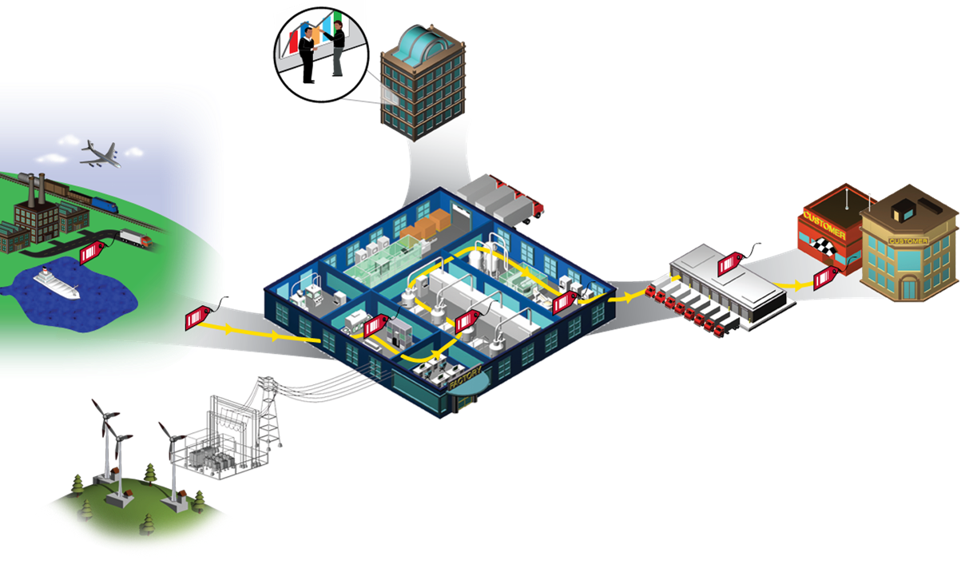
What is Smart Manufacturing Value Chain Networked-Based Manufacturing
EDI transaction
lot & quality
certifications
Business Systems, ERP
Mapping SAP information
Into operation
Customer
Supply Chain
Distribution Center
Smart Factory
Tracking &
traceability
Dynamic plant configuration and readiness
Dynamic product component/material configuration
Dynamic inventory minimization & management
Smart Grid
Graphics courtesy of Rockwell Automation

Slide 6
What is Smart
Smart Manufacturing Intelligence
Deeper understanding of the manufacturing process through modeling and analysis
New capacity to observe and take action on integrated patterns of operation through networked data, information, analytics, and metrics
Dynamic management of energy and material resources
Smart Manufacturing Practice
Generating and orchestrating the use of sensor-based, data-driven manufacturing intelligence
Applying integrated performance metrics constructed for real-time action
Reusing, scaling and repurposing integrated practice using a common infrastructure
Smart Manufacturing Execution
Dynamic orchestration of decision/action workflows in heterogeneous environments without losing control of state
across different time constants and seams, including supply chain
multi-vendor discrete, continuous, operational and human/social applications
Applications that can share data and data that can share

Slide 7
Smart Systems Testbed Types
Smart Machine Line Operations | In-Production High Fidelity Modeling | Dynamic Decisions | Enterprise & Supply Chain Decisions | Design & Planning
Machine product management | Better management complex behaviors | Performance management global integrated decisions | Variability reduction | Design models in production
Benchmarking machine-product interactions | Rapid qualification components products materials | Untapped enterprise degrees of freedom in efficiency, performance time | Risk and compliance management | Product/material in-production ability
Machine-power manage management | Integrated computational materials engineering | Business operational tradeoff decisions | Tracking traceability genealogy | New product, material technology insertion
Adaptable machine configurations |  |  | External partner integration into business process

Slide 9
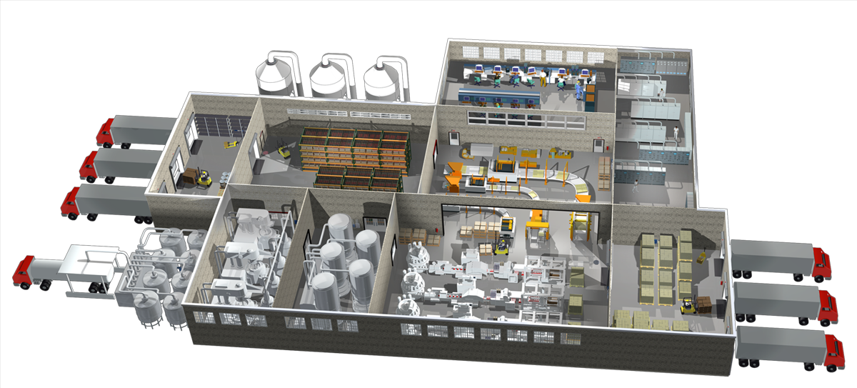

Smart Manufacturing: Multi-Layered
Seams, Time, Data & Action
Machines – People - Materials Dynamic Manufacturing Ecosystem
Design
Data
In Service
Prototype
Materials & Process Tech
Product Manufacturing
Qualification
Macro Layer
Focus: 10x Multiple Pass Variability Reduction; Supply Chain Information
10s
control loops
Time – days
Meso Layer
Focus: 100x Event Variability/Tradeoff Adjustment; Dynamic Performance Mgmt.; Integrated Metrics
Control & Automation
Business Systems
100s
control loops
Time -hours
1000s
control loops
Time - minutes
Micro Layer
Focus: Insertion, Qualification, ICME, High Fidelity Dynamic Operations

Slide 10
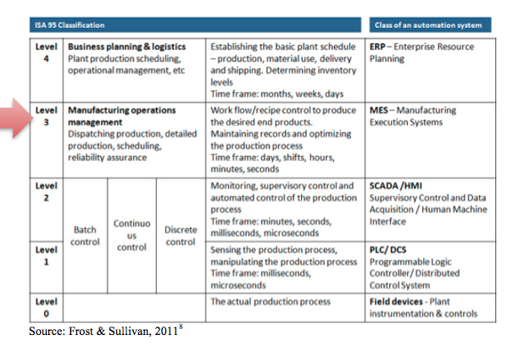
Smart Manufacturing based on ISA 95

Slide 11

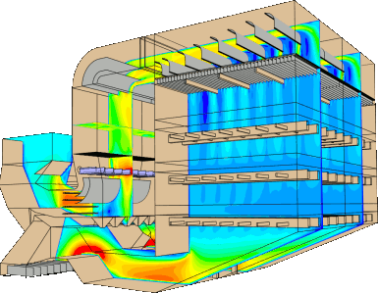
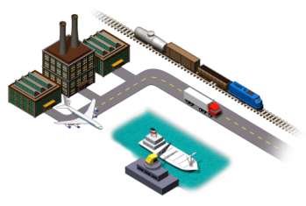
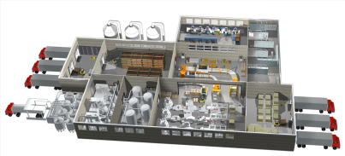

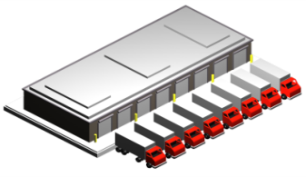

Smart Manufacturing Ecosystem
Power Mgmt &
Energy Grid
Smart Manufacturing
Platform Open Infrastructure
Heating & Forging
SM Software Marketplace
Line Operations
Suppliers
SM Value Proposition
Distribution
Applications
Sustainability
& Safety
Context
Mapping
Private
Smart Manufacturing
Platform Appliance
Data
Customers
Event Data
Time Series
Production
Models
Calibration &
Maintenance
Sensor
Data
Traditional Manufacturing Automation
Environment and Software Tools

Slide 12
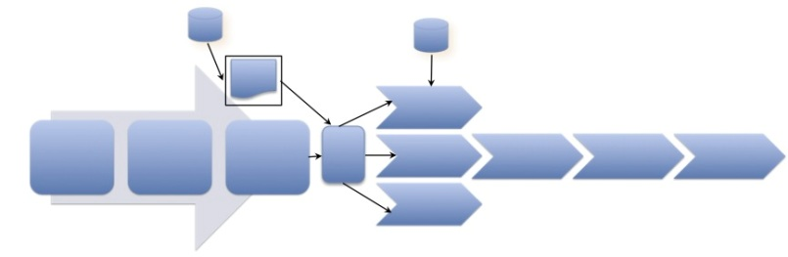
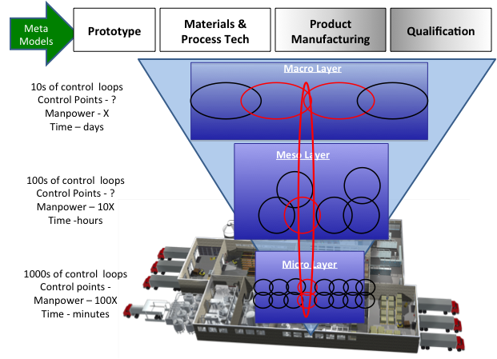




WfaaS Integrated with SaaS, PaaS, IaaS
Workflow (WfaaS)
Data-based Workflow
Orchestration
Provisioning
Orchestration
Tasking
State
Proprietary Workflow
Security
Provenance
Application Instances

Slide 13
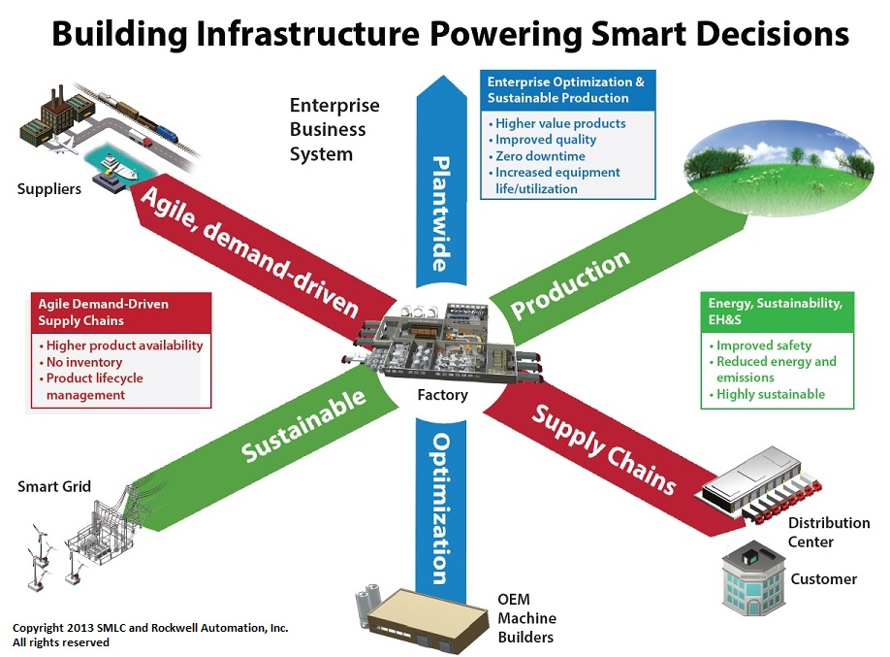
Smart Manufacturing’s Commitment to a Comprehensive Approach

Slide 14
Industry-Academic-Government Collaboration Model
SMLC Industry-Driven
Integrated Performance Metrics
Micro, Meso, Macro
SMEs
Small & Medium Enterprises
Manufacturing Consortia
Machine Product Management
In Production High Fidelity Modeling
Design and Planning
Dynamic Decisions
Enterprise & Supply Chain
Decisions
SM Platform
Open-architecture
Cloud-based
Test Bed
Manufacturer
& Supplier
Crosslinking
Engagements
Composable
Workflows Apps &
Toolkits
Real-time Data &
Modeling Workflow
& Metric Toolkit/
App Development
Apps &
Toolkits
CommunityResources & Data Services
UCLA
Benchmarking
Rapid Qualification
Variability Management
Real-time Plan Passes
Performance Management
Tracking, Traceability
ICME
Key
Development
Resources
Universities, SME’s
Manufacturers, Labs
Modeling & Interoperability Protocols
IT Providers
Marketplace
SMLC Collaboration Model

